Slide 1
OOSd (Object Orientated Software Development)
C # overview
Programming Elements and constructs
John Walsh

Slide 2
Overview
Programming Elements & constructs
Variables & constants
operators
Software Development Method (Analysis, Design, Refine Algorithm, Pseudo Code, Implementation)
String
Console
IF Statement
Switch Statement
Logical Operators
Iteration / Looping
While && Do..While
For loop
Arrays
Elements of Arrays
Assigning Values Example
Using Array Length)

Slide 3
Programming Elements & Constructs
Variables & constants
operators
Software Development Method
Analysis, Design, Refine Algorithm, Pseudo Code, Implementation)
String
Console
IF Statement
Switch Statement
Logical Operators
Iteration / Looping
While && Do..While
For loop
Arrays
Elements of Arrays
Assigning Values Example
Using Array Length)

Slide 4
Variables & constants
Variable (Job is to store a value to be used in the program)
– a memory location used to store data (e.g store price of a ticket, store persons surname)
3 properties
Memory location to store the value
The type of data stored in the memory location
The name used to refer to the memory location
Syntax of variable declaration:
data type variableName;
Example : int num; float f1; string fName = “John”;
Constants
If we want a value to remain fixed we use a constant
A constant must be assigned a value at the time of its declaration
const x = 1;

Slide 5
operators
An operator operates on data.
The data could be a variable or a constant or a more complex expression e.g 45 + 67 is an arithmetic expression
The data on which the operator operates is called the operand.
An operator always returns a value after the operation is finished.
Operators have two important properties, precedence and associativity.
Operator Precedence
Operator precedence is similar to precedence we would
have seen in a mathematical context i.e. *, /, + , -
Operator Associativity
The associativity of an operator applies in an expression containing two or more occurrences of the same operator or operators that have the exact same precedence.
Consider the expression 7 − 4 + 2. The result could be either (7 − 4) + 2 = 5 or 7 − (4 + 2) = 1. The former result corresponds to the case when + and − are left-associative, the latter to when + and - are right-associative.
Notes:
Operators can also be classified according to the number of operands that they require.
Binary = 2 operands e.g. a + b;
Unary = 1 operand e.g. -,e.g. - (a + b), a++;
Ternary = 3 operands

Slide 6
operators
Operators are divided into three groups:
Assignment Operators
Equals sign. has the lowest precedence of any operator, so it is always the last operation to be performed in any statement.
counter = counter + 1;
Arithmetic Operators
C# provides the standard operators * , / , + ,- and % for multiplication, division, addition, subtraction and remainder (integer division)
Other important arithmetic unary operators are increment (++) and decrement (--)operators.
x++ increments x by 1, y– decrements y by 1
Logical Operators
`Not ! inverts the value of its operand
And && (eg. If a is true and b is true then a && b is true)
Or || (eg. If a is true and b is false then a || b is true)
Notes:
++ x ; //prefix incemention
x++; // postfix incremention

Slide 7
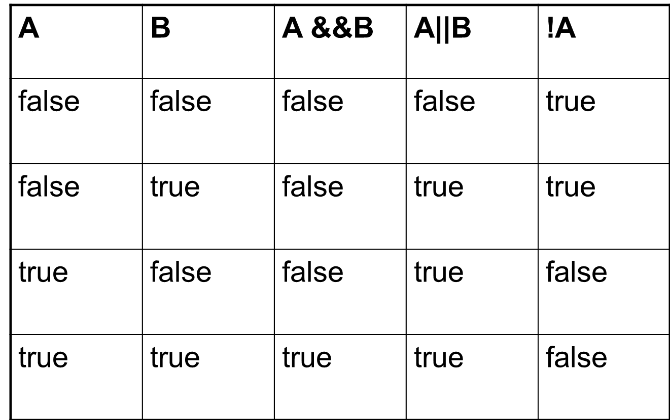
Logical operators Truth Table

Slide 8
Software Development Method
The problem: To convert fabric measured in square meters to square yards
Analysis : Define inputs and outputs
Design : Formulate algorithm
Refine Algorithm
Write PseudoCode
Implementation (write code)
Notes:
Software Development Methodology
Problem
“To convert fabric measured in square meters to square yards”
1. Analysis
Define the input and output
Input = The fabric size in square metres, 10
Output = The fabric size in square yards
Anything else (e.g.) formula that you know already
Formula:1 square metre = 1.196 square yards
2. Design
Formulate the algorithm i.e. the steps needed to solve the problem
Algorithm (Pseudocode)
Begin
Input the fabric size in square metres
Convert the fabric size to square yards
Output the fabric size in square yards
End
3. Refining our algorithm
Take any step from above that is not detailed enough and add the additional detail so it can easily be converted to statements in a programming language i.e. C#
Step 2(above) is
Convert the fabric size to square yards
Refinement of Step 2
fabric size in square yards = 1.196 * fabric size in square meters
4. Write pseudoCode
Begin
fabricSizeMetres = 10
fabricSizeYards = 1.196 * fabricSizeMetres
Output fabricSizeYards
End
5. Implementation (of the solution)
Code the program in a computer language
Define the areas in memory to hold the data(variables)
Define any constant values
Convert the steps to C# code (FabricConversion.cs)
public class FabricConversion
{
public static void main(String args[])
{
//your code goes here
//specify data first
//then steps converted from pseudocode solution
}
}

Slide 9
String
A String is an object. That object contains data, namely the sequence of characters that make up the string.
It is much more complex than a primitive data type (char or int)
It is a sequence of any characters, letters, numbers, punctuation etc.
It has numerous methods (functions of string class) that can be called to manipulate strings as desired by the programmer
n String FName = “John”;
String AllCapitals = Fname.ToUpper();
Strings are immutable, i.e. once they are created they cannot be changed.
NB : That is why all string methods return a string (as they can’t change existing string)

Slide 10
String
OO Design
Objects
Classes
Encapsulatin
Inheritance
Polymorphism
Some string methods :
string str = "abc";
int len = str.Length; //returns length of string ie. 3 . Length is property, not method!
bool trueorfalse = str.Contains("ab"); //returns boolean (true or false) value
int pos = str.IndexOf('b'); //return position of first occurrence of character b
string big = str + "def"; //string concatanation

Slide 11
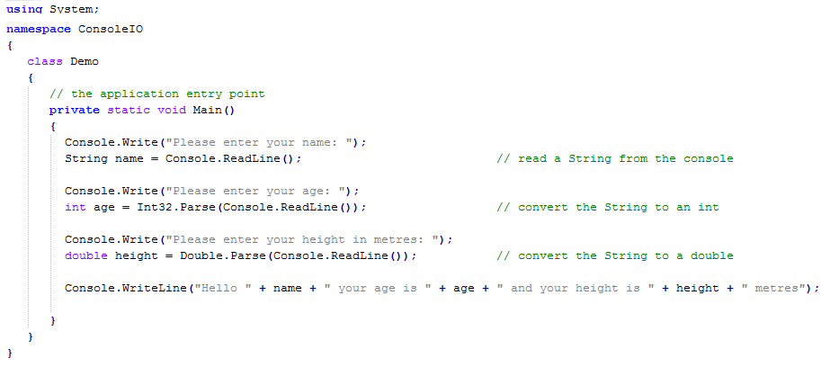
Console
The ‘Console’ class provides methods that allow us to print output to the screen and accept input from the user

Slide 12

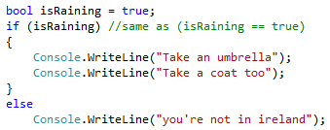
IF Statement
Most programs we write need to make decisions
A condition is tested and the program operates differently based on the outcome of the test
Use { } to indicate start and end of condition block

Slide 13
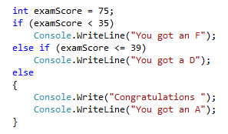
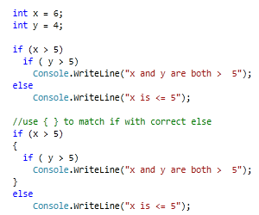
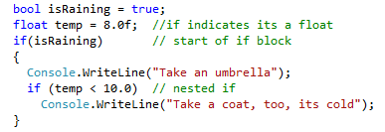
IF Statement : More examples
Careful!! This else refers to preceding if
Nested IF (if inside an if !)

Slide 14
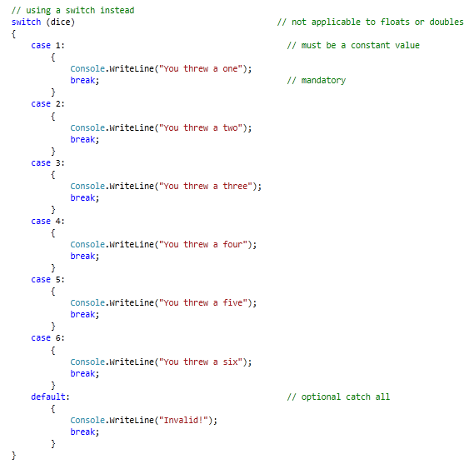
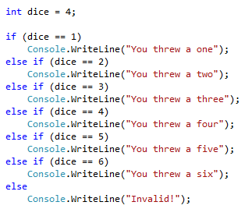
Switch Statement
OO Design
Objects
Classes
Encapsulation
Inheritance
Polymorphism
== equality operator
NB: Need break to ‘break out’ of switch statement
This If statement can be written as switch statement

Slide 15
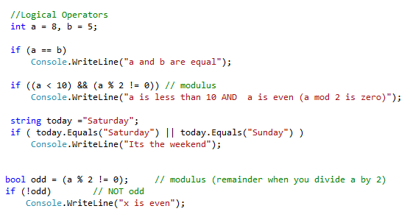
Logical Operators
== equality operator
&& Logical and
|| logical or
! Not operator
% mod (remainder when
you do integer division
Don’t get these confused

Slide 16
Iteration / Looping
while loop
do..while loop
for loop
Notes:
Software Development Methodology
Problem
“To convert fabric measured in square meters to square yards”
1. Analysis
Define the input and output
Input = The fabric size in square metres, 10
Output = The fabric size in square yards
Anything else (e.g.) formula that you know already
Formula:1 square metre = 1.196 square yards
2. Design
Formulate the algorithm i.e. the steps needed to solve the problem
Algorithm (Pseudocode)
Begin
Input the fabric size in square metres
Convert the fabric size to square yards
Output the fabric size in square yards
End
3. Refining our algorithm
Take any step from above that is not detailed enough and add the additional detail so it can easily be converted to statements in a programming language i.e. C#
Step 2(above) is
Convert the fabric size to square yards
Refinement of Step 2
fabric size in square yards = 1.196 * fabric size in square meters
4. Write pseudoCode
Begin
fabricSizeMetres = 10
fabricSizeYards = 1.196 * fabricSizeMetres
Output fabricSizeYards
End
5. Implementation (of the solution)
Code the program in a computer language
Define the areas in memory to hold the data(variables)
Define any constant values
Convert the steps to C# code (FabricConversion.cs)
public class FabricConversion
{
public static void main(String args[])
{
//your code goes here
//specify data first
//then steps converted from pseudocode solution
}
}

Slide 17
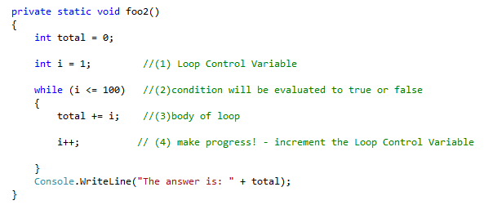
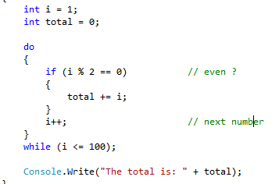
While && Do..While
While loop
Syntax :
while (condition) {
statement(s)
}
Do .. While loop
Do..While syntax :
do {
Statements
} while ( condition );
Always loops at least once (because loop condition test comes after loop body)

Slide 18
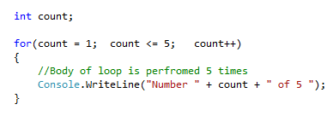
For loop
For loop
initialisation
guard
Make progress
The initialisation part is executed only once at the start of the statement
Then the guard expression is tested,
if the expression evaluates to true, the loop is entered and the body is executed
If the expression evaluates to false the loop body is skipped and program execution continues after the closing brace of the loop.
If the loop body had been executed, when the closing brace of the loop body is reached, control returns back to the for statement, the make progress part of the statement is executed, and the guard expression is tested again.
If the expression evaluates to true, the loop is entered again and the cycle continues, if the expression evaluates to false the loop exits.

Slide 19
Questions
What is the output of the following
for ( int i = 0; i < 5; i++ ){
Console.WriteLine( i + " " );
}
for ( int j = 10; j > 5; j-- ) {
Console.WriteLine( j + " " );
}
What must the test be so that the following fragment prints out the integers 5 through and including 15?
for ( int j = 5; ________ ; j++ ) {
Console.WriteLine( j + " " );
}
What must the change be so that the following fragment prints out the even integers 0 2 4 6 8 10?
for ( int j = 0; j <= 10; _______ )
Console.WriteLine ( j + " " );

Slide 20
Arrays
Arrays are used when we want to stores a large amount of data (e.g. store a 100 numbers)
An array is a (fixed number) collection of data items that all have the same name and data type.
You can think of an array as a row of post-office boxes...
each box has its own number
you can expect each box to contain something
In C# (or any other programming language) an array consists of
a row of storage locations, each labelled with a number (“index”)
the data stored at an index location is called an array element
Array elements can be any type of data you have seen so far
There is one major restriction: they must all be of the same type
element
0
element
1
element
2
.....
element
n-1
[0] [1] [2] [n-1]
indexes

Slide 21
Elements of Arrays
Arrays are complex variables that hold multiple instances of the data type they are created with.
That means :
if you create an array of type String, there are several Strings in the variable, not just one.
If you create an array of 10 integers, there are 10 integers in the one variable.
Each array has the following:
data type
name
size

Slide 22
Assigning Values Example
Setting values in the array is the same as setting normal variables, with the exception that you have to use the square brackets to tell C# which value in the array you are setting.
int[] nums = new int[10]; //create an array of 10 ints (10 elements => positions 0 to 9)
nums[5] = 20; //set element at position 5 to 20
nums[8] = 2; //set element at position 5 to 20
nums[0] = 9; //remember index starts at 0, so first element is [0]
nums[9] = 3; //remember last index is at position 9,: (10 elements => positions 0 to 9)
Remember, you can place any value you like in a array, as long as it is of the same type that the array was declared with.

Slide 23
Assigning Values Example
salesFigure[0]
salesFigure[1]
salesFigure[2]
salesFigure[19]
2000
0
5000
.....
120
salesFigure[0] = 2000;
salesFigure[2] = 5000;
salesFigure[19] = 120;
//Say i is an int; then
salesFigure[2] = 64; //is equivalent to
Int i = 2;
salesFigure[i] = 64;
What values does the array hold now?
Consider the following:
salesFigure[0] = 10;
salesFigure[1] = 35;
salesFigure[2] = salesFigure[0] + salesFigure[1];
What values does the array hold now?
[0] [1] [2] [n-1]
indexes

Slide 24
Using Array Length
When you work with arrays you must ensure the index you use remains in the range zero up to length -1.
To access all elements of the salary array (previous slides) , you can use the number 20 explicitly, ie,
for (x = 0; x < 20; x++)
But, if you modify your program to hold more or fewer array elements you must remember to find and replace each reference to 4.
A better technique is to use salary.length
ie. for (x = 0; x < salary.length; x++)
That way, even if you change the size of the array, the array will always use the correct maximum length.

